Slide 1
Nurses Well-Being Dr. Kaye Wilson-Anderson

Slide 2
Background
Grew up in MS Delta in Leland, MS
Practice—Women’s Health, L & D and Population Health
Faculty
1985-2002 Mississippi College
2002-2006 University of Mississippi
2007-2021 University of Portland
2021-Present George Fox University

Slide 3
Nursing Service
International Service Trips | State and Local Mississippi Delta ** Jackson, MS–Inner City ** Crisis Pregnancy Centers ** Camp Garaywa-Nursing ** Mobile Clinic-Katrina Recovery **
Ledger: Personal * Faculty/Student **
Costa Rica-1 * China-5 ** Thailand-1 * India-4 * ** Ukraine-3 * ** | Kyrgyzstan-3 * ** Chile-2 ** Mexico-5 ** Iraq-1 * Gaza-1*

Slide 4
Daily Spiritual Experience
Sustaining Nurses Well-Being

Slide 5
Overview of Nursing Literature
Gracia (2021) Nightingale’s Holistic Nursing Approach
Jasemi et al. (2017) Importance of Holistic Health
Pollock et al. (2020) Interventions to Foster Nurses’ Resilience and Mental Health
Dall’Ora et al. (2020) Reported Burnout and Nursing
Shortage
Celano et al. (2022) Moral Distress, Burnout and Compassion
Fatigue
Irandoost et al. (2022) Reported Nurses Who Engaged in
Spiritual Activities had Decreased Burnout
and Compassion Satisfaction

Slide 6
Literature Continued
Missouridou et al. (2022) Healthcare Systems and Nurses Must
Focus on Emotional Well-being.
Kunzler et al. (2020) 30 RCTs Recommended Resilience Training
Roberto et al. (2020) Participants’ Faith and Spirituality Aided Them
in Coping with Everyday Experiences and
Provided Hope for the Future
Jans-Beken (2021) Gratitude, Actions of Kindness, Expressing
Thankfulness for Life and God Increases Coping

Slide 7
What Does a Daily Spiritual Experience Involve?
Gratitude
Music
Scripture
Exercise
Solace with God
Being in Nature

Slide 8
The Impact of Spiritual and Religious Beliefs on the Professional Well-Being of Nurses (Wilson-Anderson et al, 2022)
Background: Panel of George Fox Nursing Alumni shared “living and practicing in the midst of COVID-19”.
Method: Survey Monkey Link [General Anxiety Disorder-7 Scale (GAD-7), Connor-Davidson Resilience Scale-10 (CDRS-10) Daily Spiritual Experience Scale (DSES) and Professional Quality of Life Scale (ProQOL)]
Results: n=83, nursing students = 34, nurse educators=11, nurses= 38 with a final n = 79, participants completing the study tools.
Conclusion: 1)Nurses and nurse educators experienced statistically significant high levels of anxiety, as well as, burnout and secondary trauma.
2) Nurses who reported having a Daily Spiritual Experience were found to have a statistically minimal lower levels of burnout and increased resilience and statistically significant increase in resilience and compassion satisfaction.

Slide 9
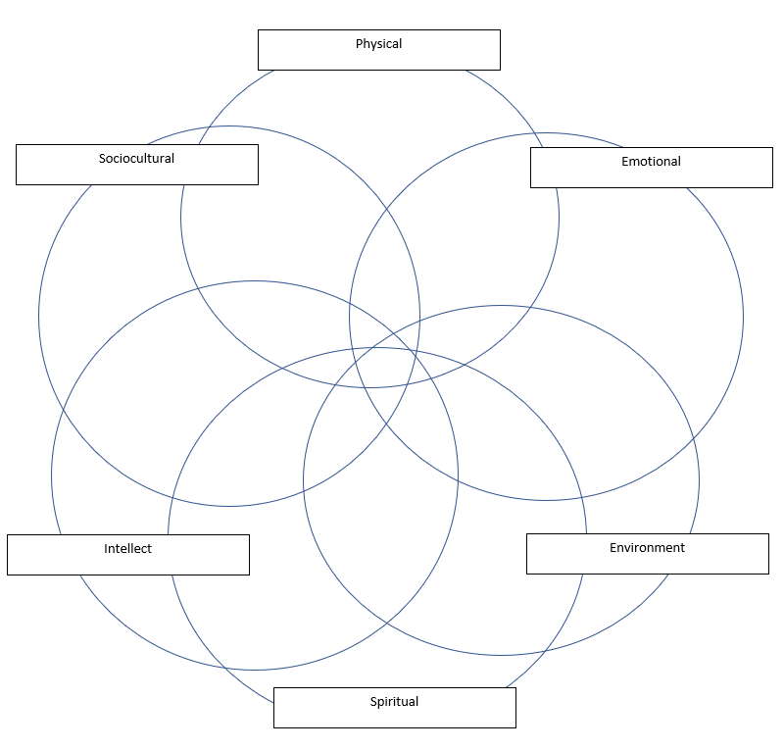

Slide 10
Assessing a Client’s Spirituality
What brings you hope?
Where do you find peace?
What or who brings you comfort?

Slide 11
